Slide 1
WELCOME TO YEAR SIX
(Red Kites and Falcons)

Slide 2
Our Values
Kindness
Kindness is a high moral standard. We support our pupils in understanding the impact our words and actions have on others, the community around us and the world we live in.
Health
We will promote a healthy lifestyle, including the importance of physical activities, mental health, healthy eating and healthy relationships. Teaching pupils to assess risks, to reduce the potential of harm to themselves or others and in doing so develop a strong self-esteem and a sense of purpose.
Respect
We recognise and respect differences in race, religion, disability, physical appearance, ability and gender. We treat everybody the same, regardless of these differences. We have respect for ourselves and each other. We respect the property of others and our environment.
Courage
We will encourage children to have a voice and to be confident in their own opinions. We want our pupils to have the confidence to face different situations with feelings of ease, believing in our own capabilities.

Slide 3
Our Team
Teacher – Mrs Hood (Redkites)
Teaching Assistant – Miss Millie
Teacher – Mr Wheeler (Falcons)
Teaching Assistant – Mrs Eastwood (Falcons)
Mr Bilsby (Tuesday pm)
Mrs Gazza (Tuesday pm)
Mrs Moss (Thursday 13:15 – 2:15) Falcons Only

Slide 4
Uniforms
Black school shoes (not trainers).
P.E. kit worn on PE days including tracksuit bottoms/jogging bottoms for when the weather gets colder. No branded hoodies or jumpers to be worn.
PE days for both classes – Tuesday/Wednesday
Hair bands, ribbons and slides must be red, black or white.

Slide 5
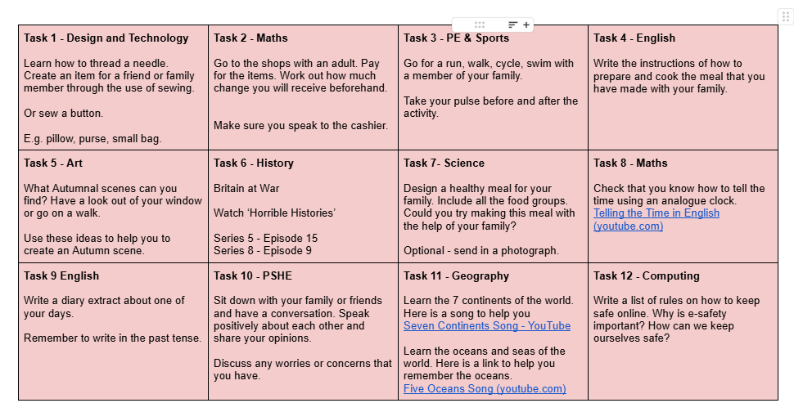
Homework

Slide 6
Homework
A piece of work from the CPG workbooks will be set on a Monday
Both due in the following Monday
Spellings will be set on a Tuesday and tested the following Tuesday.
Homework will consist of
  Spellings
  Reading (20 minutes a day - recorded at least three times in reading diary – checked on a Friday).
  One piece of work from CPG workbooks
  Times tables (through Times Table Rock Stars)
  One piece of optional family homework
Presentation – handwriting pen used for writing, pencil for drawing and a ruler for any lines.

Slide 7
Communication
If you would like to speak to us outside parents’ evening times, please feel free to email or make an appointment through the office.
Alternatively, if it is a quick discussion, then please catch us on the door before or after school.

Slide 8
Key Events
Open Evenings – Secondary ?
KS2 Tests – 10th – 13th May
Taster Days – July
School Production – TBC (end of summer term)
Residential Trip – Overstrand Hill – 28th June – 2nd July

Slide 9
School Day
Monday | Registration | EMS |  |  | Maths | Snack | Playtime | English |  | History | RE
Tuesday | Registration | EMS |  |  | Maths | Snack | Playtime | English |  | Art | PE
Wednesday | Registration | EMS |  |  | Maths | Snack | Playtime | Snack |  | PE | Arithmetic

Slide 10
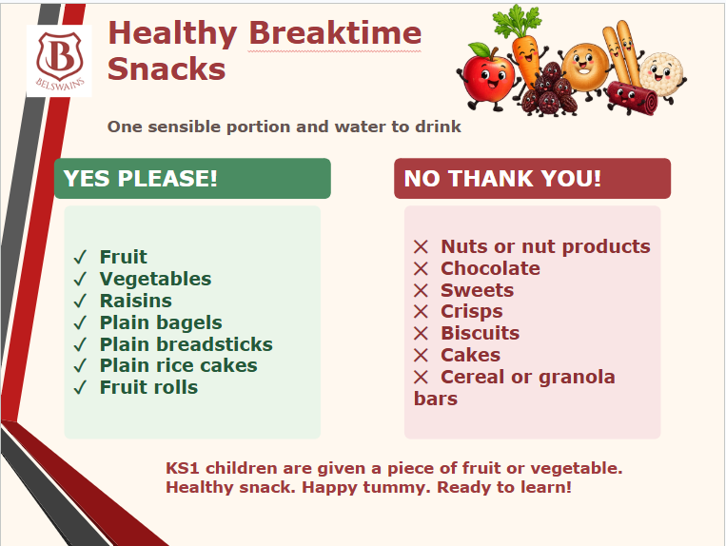

Slide 11
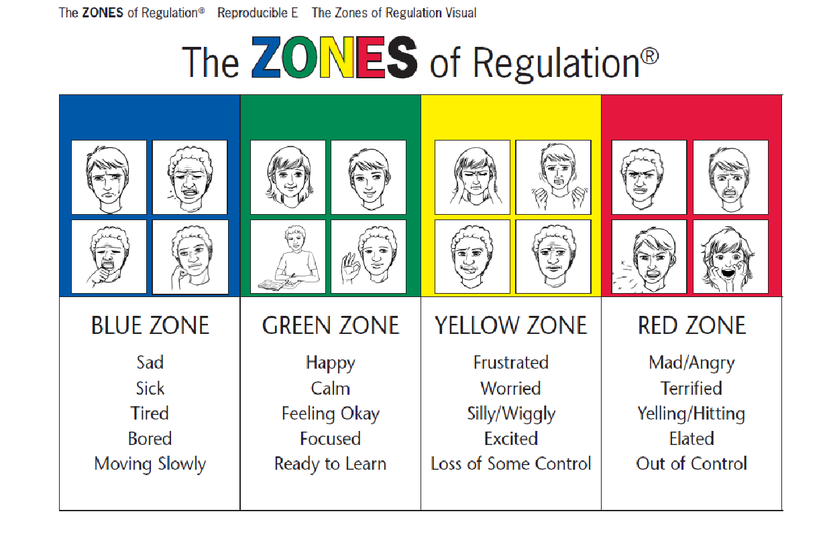
Mental Health and Wellbeing

Slide 12
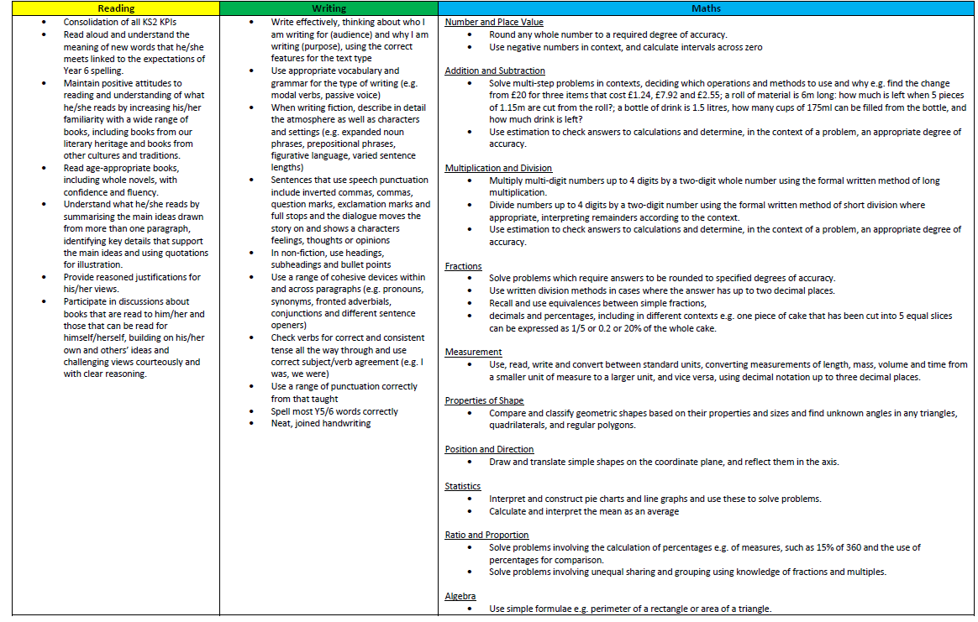
Key Performance Indicators

Slide 13
Permission
Just a reminder that we love to share photos of activities and events the children have taken part in.
If you haven’t already (and wish to), please give your consent via Arbor.

Slide 14
Questions
Would you like to ask any questions?
Is there anything further you wish to know?

