Slide 1
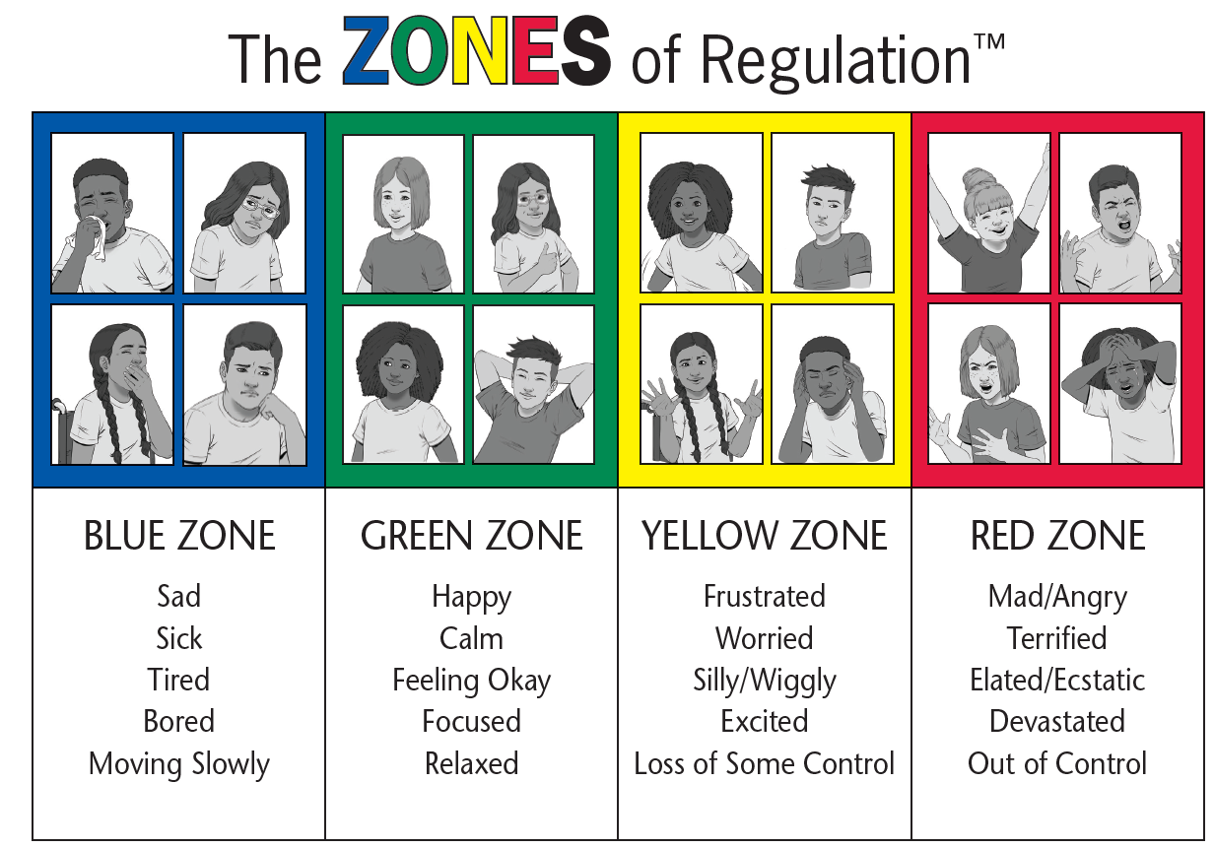
Sad Tired Sick Lonely | Happy Excited Ready to learn Proud | Frustrated Wiggly Worried | Angry Scared Out of control Hurt

