Slide 1
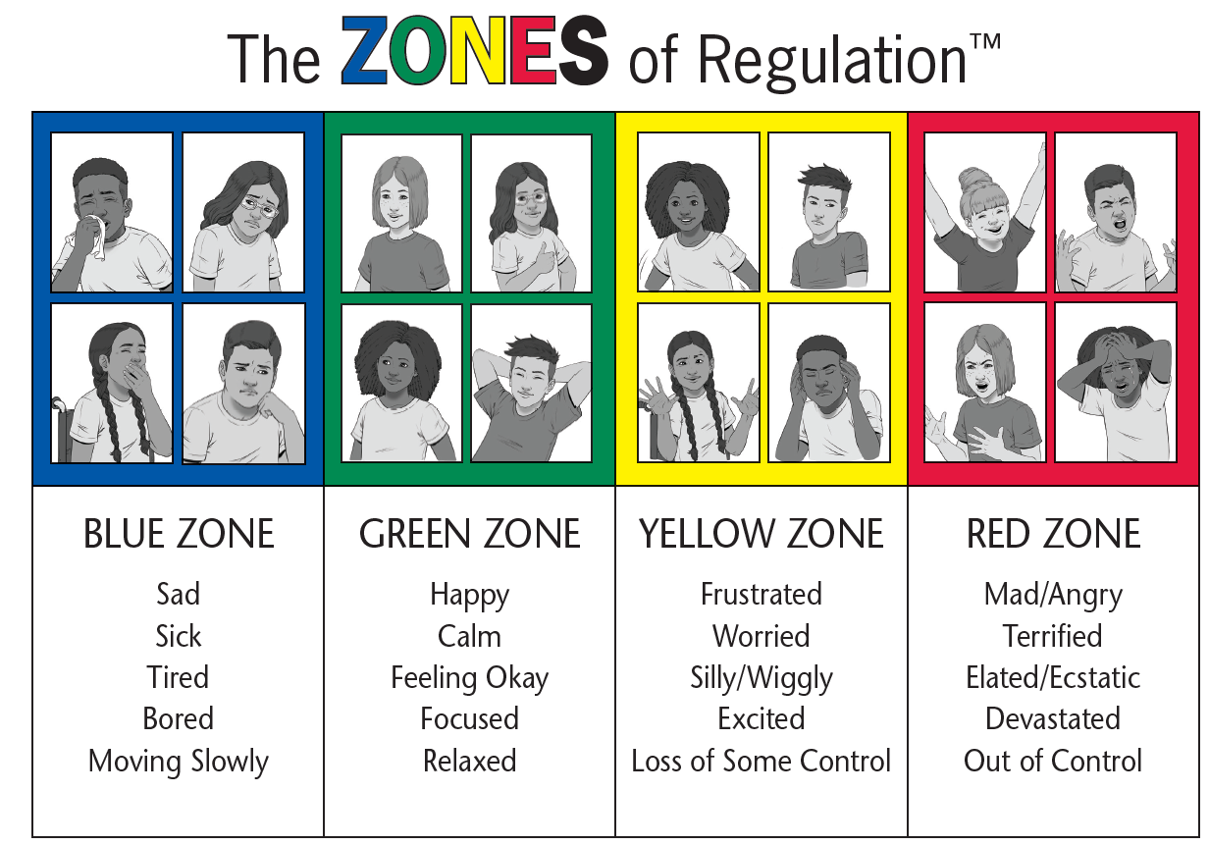
Tired Sad Disappointed Sick Lonely | Ready to learn Excited Proud Cheerful Optimistic | Worried Frustrated Anxious Nervous | Grumpy Annoyed Jealous Scared Angry

