Slide 1
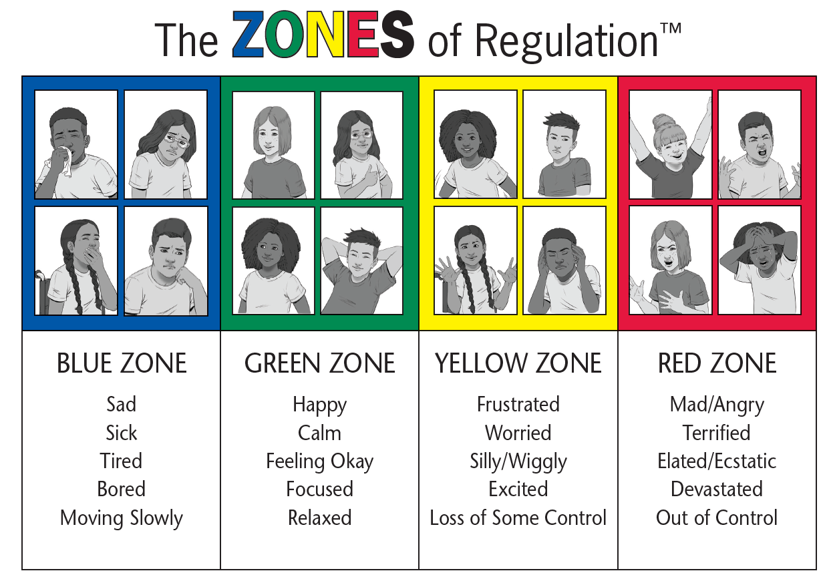
Exhausted Sad Disappointed Sick Lonely | Ready to learn Excited Proud Cheerful Optimistic | Overwhelmed Anxious Nervous Irritated | Disappointed Jealous Scared Angry Frustrated

