Slide 1

WELCOME TO YEAR FIVE
September 2026

Slide 2
Our Values
Kindness
Kindness is a high moral standard. We support our pupils in understanding the impact our words and actions have on others, the community around us and the world we live in.
Health
We will promote a healthy lifestyle, including the importance of physical activities, mental health, healthy eating and healthy relationships. Teaching pupils to assess risks, to reduce the potential of harm to themselves or others and in doing so develop a strong self-esteem and a sense of purpose.
Respect
We recognise and respect differences in race, religion, disability, physical appearance, ability and gender. We treat everybody the same, regardless of these differences. We have respect for ourselves and each other. We respect the property of others and our environment.
Courage
We will encourage children to have a voice and to be confident in their own opinions. We want our pupils to have the confidence to face different situations with feelings of ease, believing in our own capabilities.

Slide 3
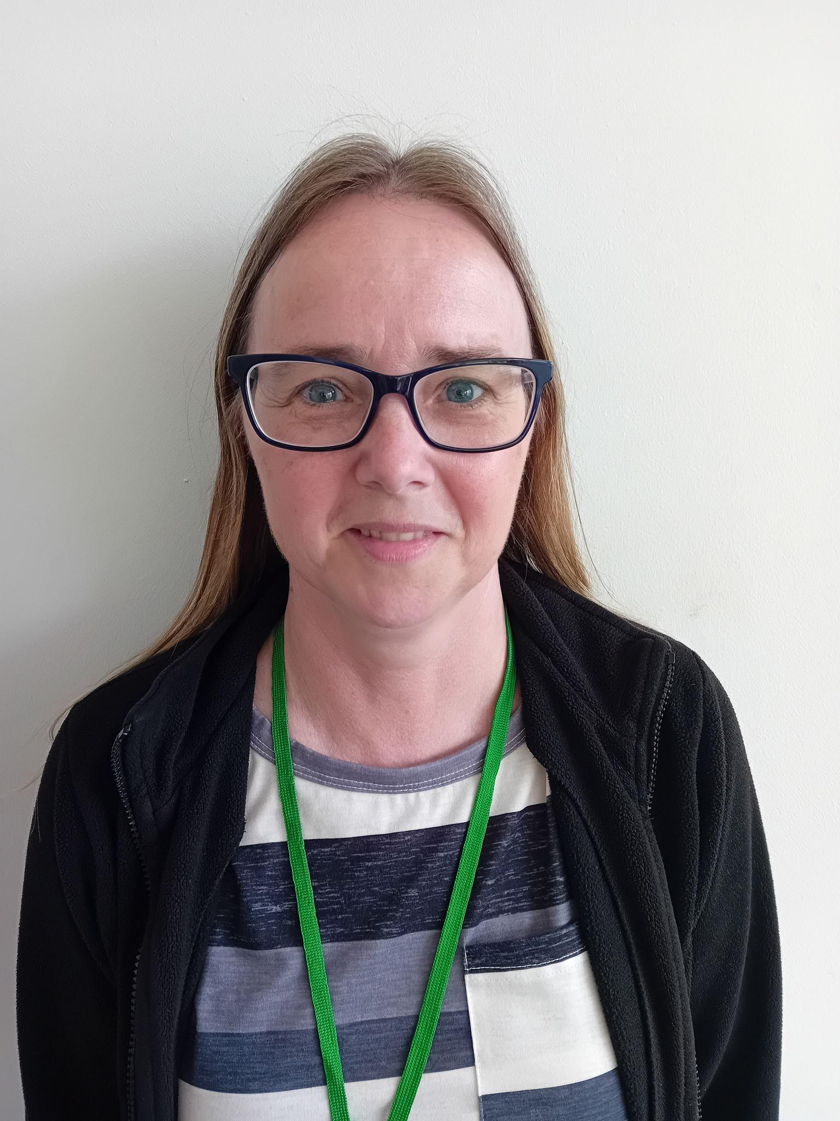
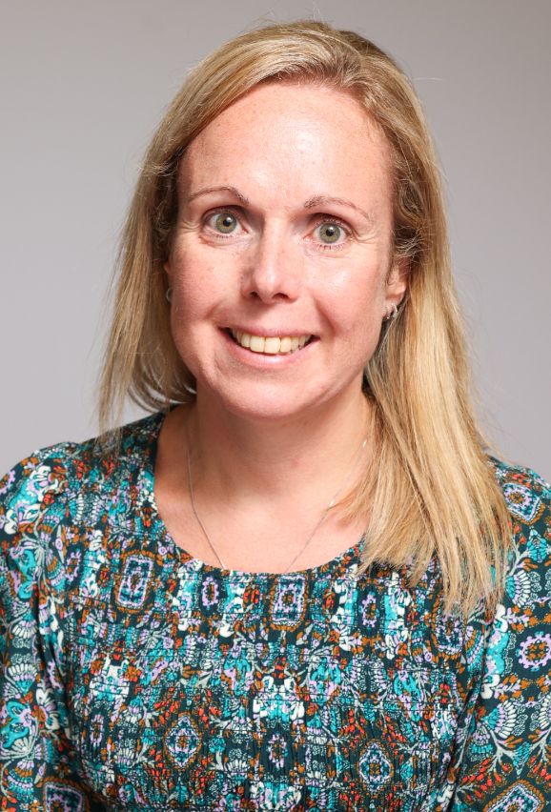
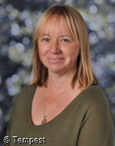
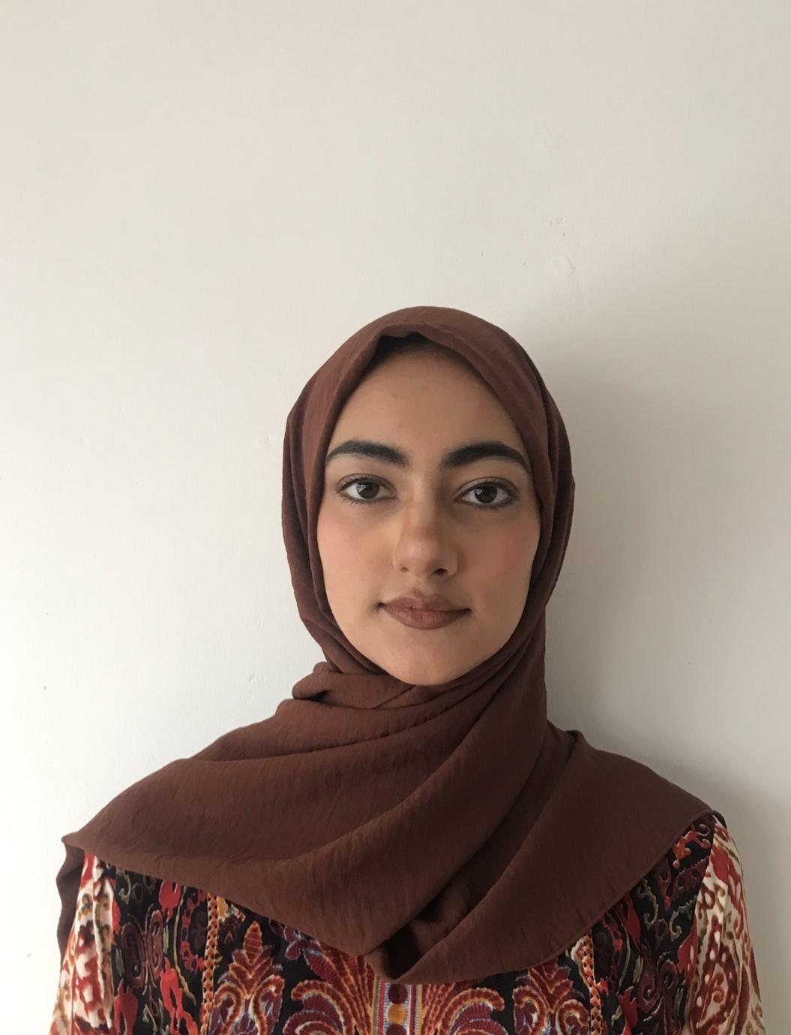
Our Team
Eagles
Hawks
Mrs Raffety- Class teacher
Miss Seabright - HLTA
Mrs Gaze- Class teacher
Miss Ahmed - LSA

Slide 4
Uniforms
Black school shoes (not trainers).
P.E. kit worn on PE days including tracksuit bottoms/jogging bottoms for when the weather gets colder. No branded hoodies or jumpers to be worn. Shorts should be a suitable length for school (should be able to be seen below a t-shirt).
Hair bands, ribbons and slides must be red, black or white.

Slide 5
Communication
If you would like to speak to us outside parents’ evening times, please feel free to email or make an appointment through the office.
Alternatively, if it is a quick discussion then please catch us on the door before or after school.

Slide 6
Key Dates
Eagles Class Assembly - Friday 26th September
Hawks Class Assembly - Friday 26th January
Harvest Festival - 29th September
Individual School Photographs - October 8th
Author Visit - Thursday 9th October
Flu Immunisations - Monday 13th October
Lego Workshop - 15th/16th October
Science Museum Trip - Monday 10th November
Christmas Jumper & Dinner - Wednesday 17th December

Slide 7
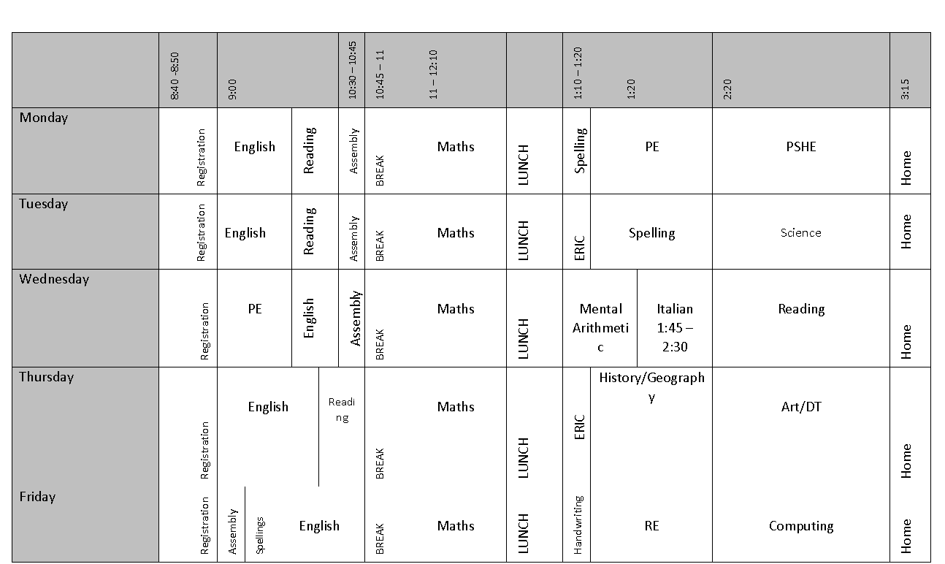

Slide 8
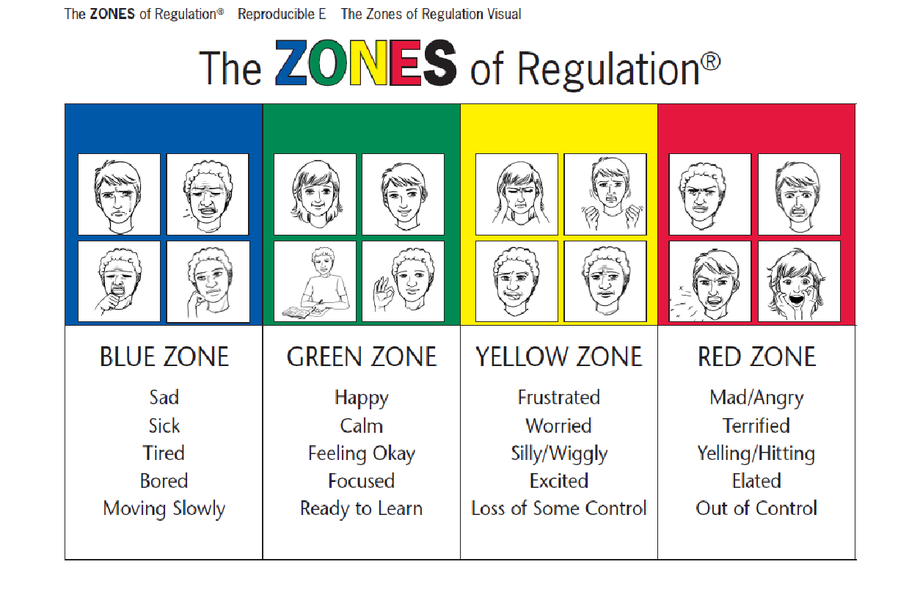
Mental Health and Wellbeing

Slide 9
Clubs
Monday- Boxing, Netball, Art Club
Tuesday- Running club (8:10am), KS2 football (lunchtime), KS2 Multisports, Choir (after school)
Wednesday- KS2 Football, iRock
Thursday - Performing Herts

Slide 10
Homework
This will consist of:
  Spellings (set and tested on a Monday)
  Reading (20 minutes a day - recorded at least three times in reading diary)
  Weekly optional family homework task
The optional family homework can be completed on google classrooms or in your child’s homework book.

Slide 11
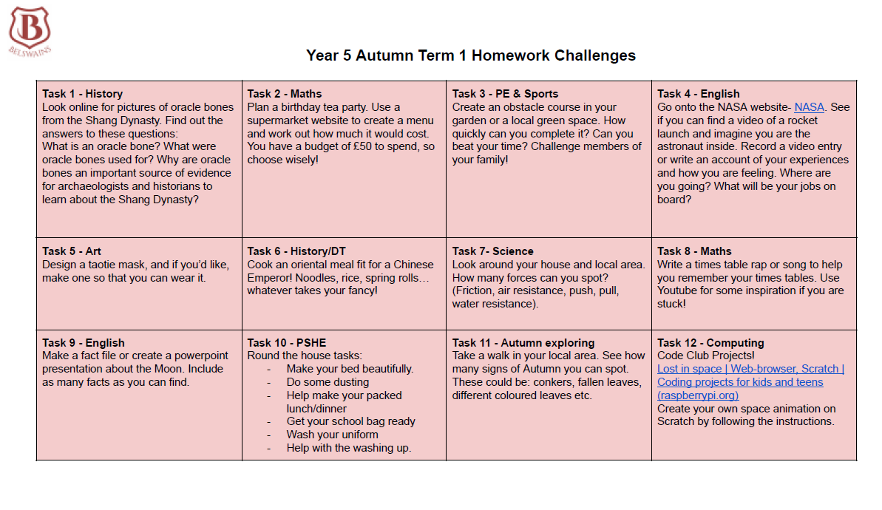

Slide 12
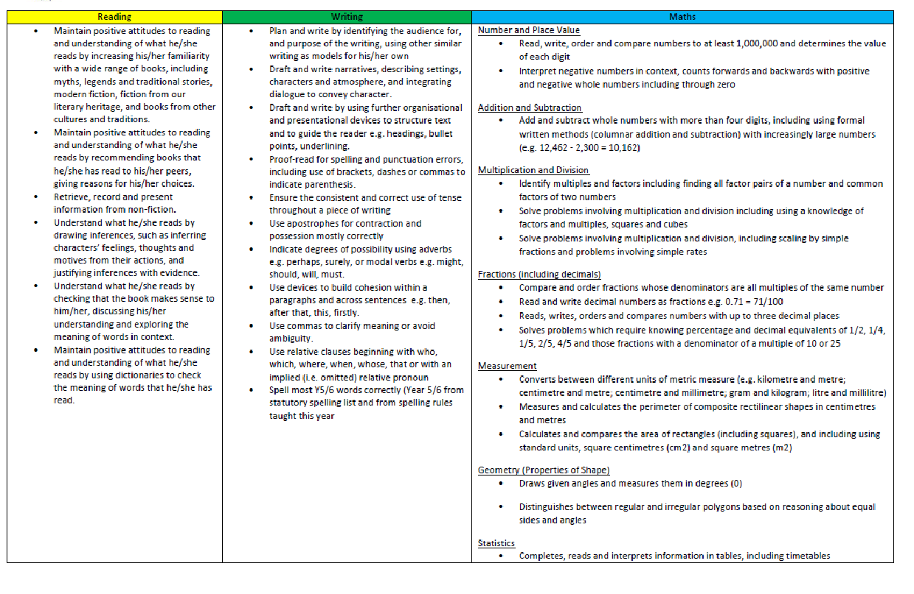
Key Performance Indicators

Slide 13
Permission
Just a reminder that we love to share photos of activities and events the children have taken part in.
If you haven’t already (and wish to), please give your consent via Arbor.

Slide 14
Questions
Would you like to ask any questions?
Is there anything further you wish to know?

